Slide 1
Chongqing University of Technology
ATAI
Advanced Technique of Artificial Intelligence
Chongqing University of Technology
Dual Graph Convolutional Networks for Aspect-based Sentiment Analysis
(ACL-2021)
code: https://github.com/CCChenhao997/DualGCN-ABSA
Reported by Ling Zhu

Slide 2
Chongqing University of Technology
ATAI
Advanced Technique of Artificial Intelligence
Chongqing University of Technology
Introduction
Motivation
Approach
Experiments
Conclusion

Slide 3
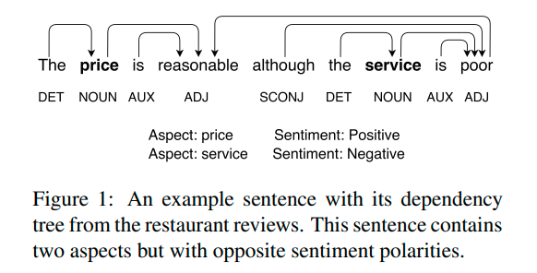
Introduction

Slide 4
Motivation
Two challenges arise when applying syntactic dependency knowledge to the ABSA task:
1) The inaccuracy of the dependency parsing results
2) GCNs over dependency trees do not work well as expected on datasets that are not sensitive to syntactic dependency due to the informal expression and complexity of online reviews

Slide 5
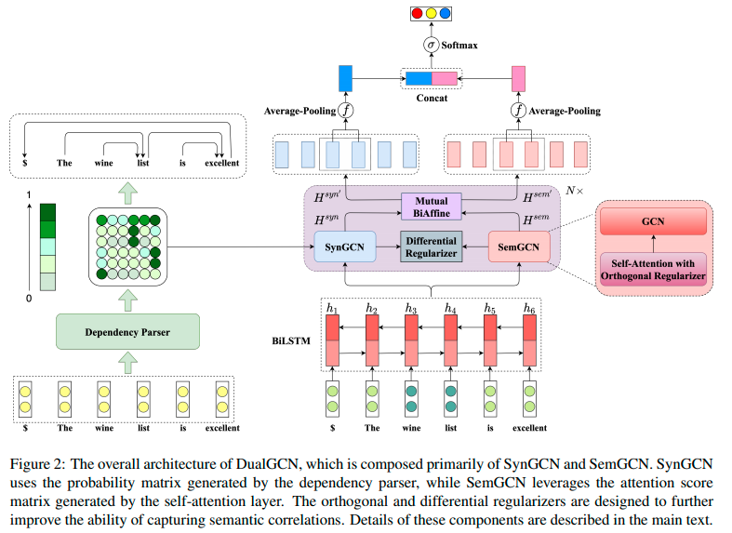
Approach
Notes:
Grid Tagging Schema
2020-EMNLP-Grid Tagging Scheme for Aspect-oriented Fine-grained Opinion Extraction

Slide 6
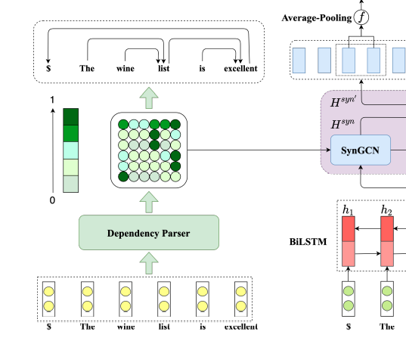
Approach
Syntax-based GCN (SynGCN)
LAL-Parser
EMNLP-2020-Rethinking Self-Attention: An Interpretable Self-Attentive Encoder-Decoder Parser

Slide 7
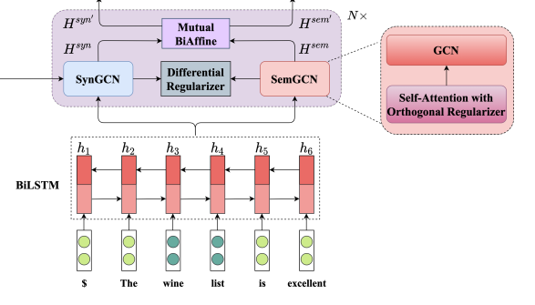
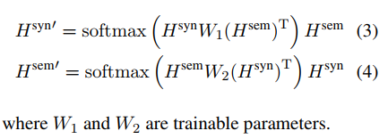
Approach
Semantic-based GCN (SemGCN)
$$Q=K=H^{syn}$$
$$H^{sem}=\{h_{1}^{sem},h_{2}^{sem},…,h_{n}^{sem}\}$$
BiAffine Module

Slide 8
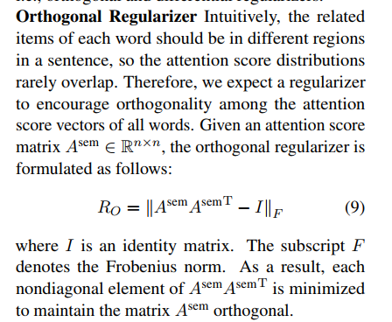
Approach
Orthogonal Regularizer
where I is an identity matrix. The subscript F
denotes the Frobenius norm
Differential Regularizer

Slide 9
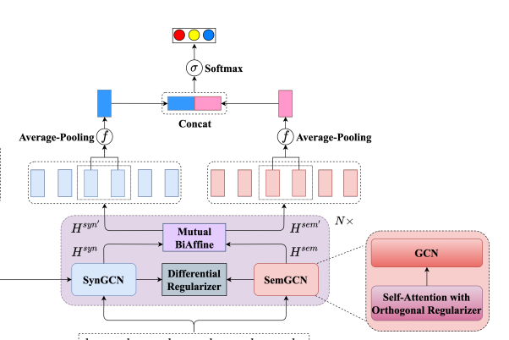
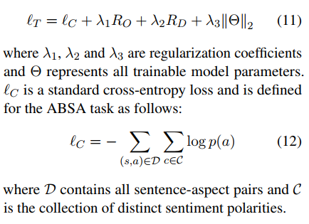
Approach
where f(·) is an average pooling function
Loss Function
Notes:
dependency label embedding

Slide 10
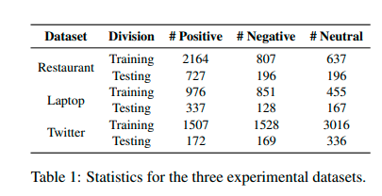
Experiments

Slide 11
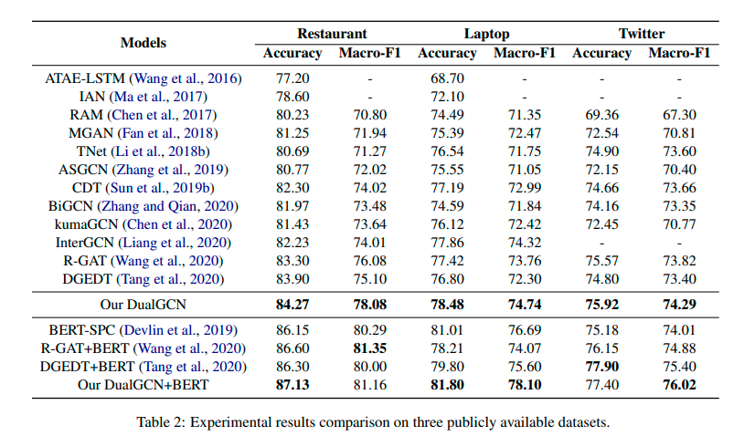
Experiments

Slide 12
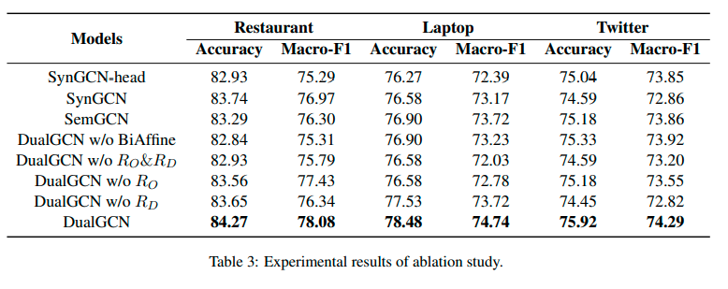
Experiments
SynGCN-head model uses the discrete outputs of a dependency parser to construct the adjacency matrix of the GCNs

Slide 13
Experiments
The notations P, N and O represent positive, negative and neutral sentiment, respectively.

Slide 14
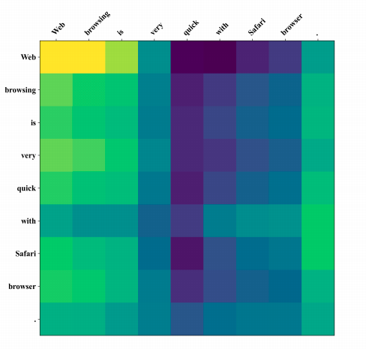
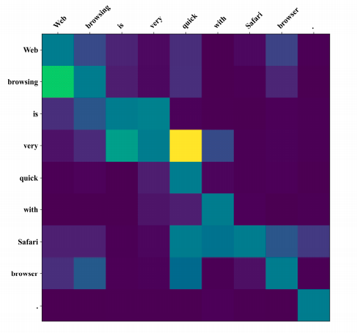
Experiments

Slide 15
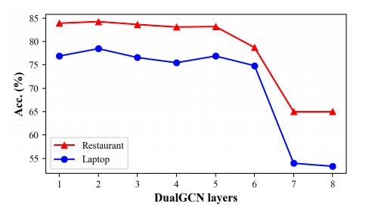
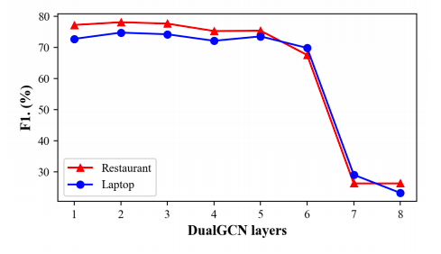
Experiments

Slide 16
Thanks

